Slide 1
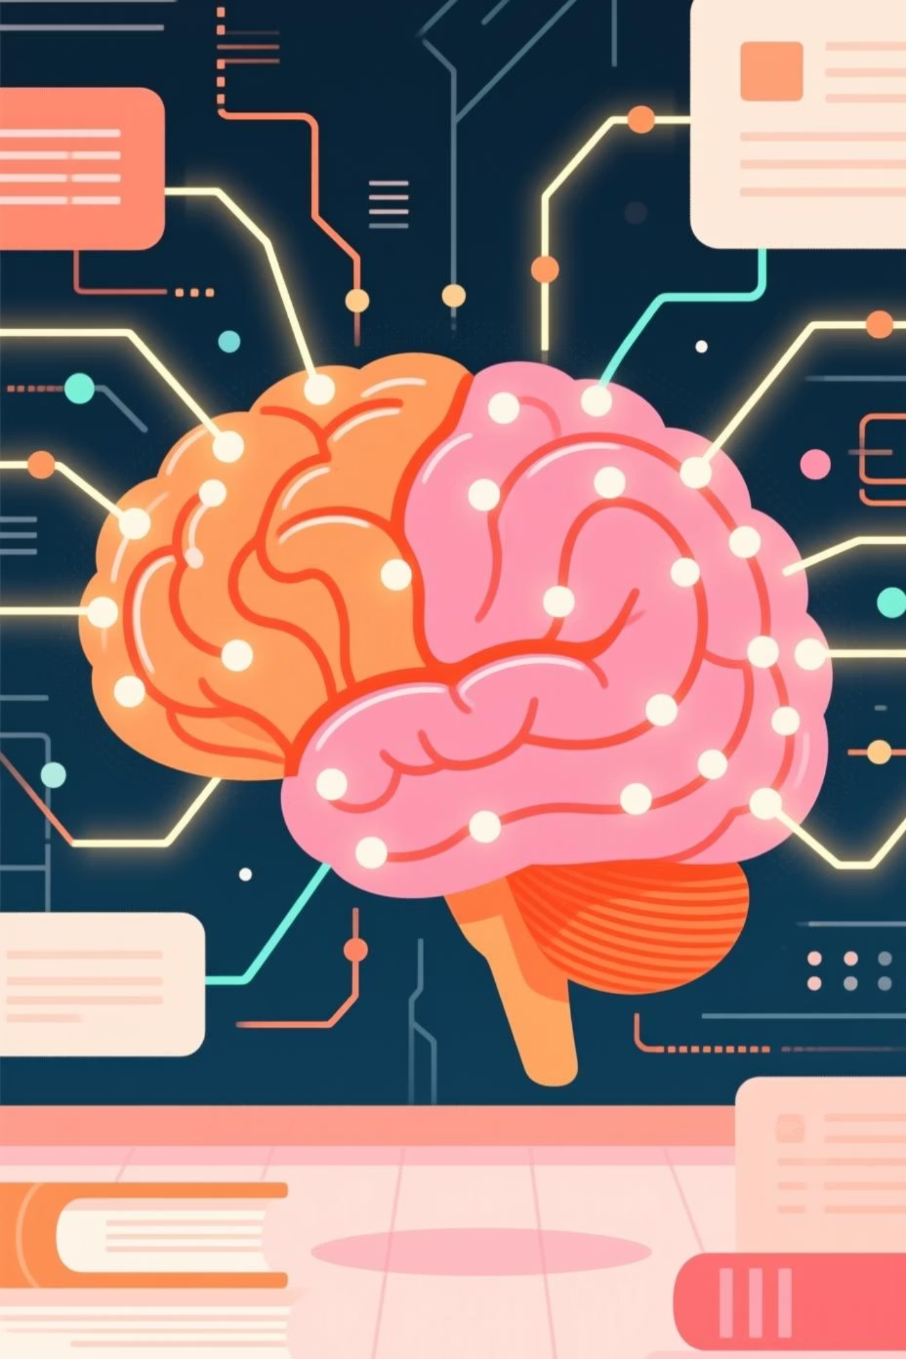
Team 3
Adaptive Quiz
&
Question Generator
Personalized Learning Through Dynamic Assessment

Slide 2

INTRODUCTION
The Need for Adaptive Learning:
Learning isn't one-size-fits-all.
Traditional quizzes often fail to cater to individual student needs, offering static, generic questions that don't adapt to understanding or learning styles.
This leads to missed learning opportunities and disengagement.
Our Solution: AI SMART QUIZZER
"AI SMART QUIZZER", the Adaptive Quiz & Question Generator, addresses this critical gap. It's designed to create personalized, dynamic quizzes from any educational content, adapting to each learner's performance and difficulty preferences

Slide 3





Project Overview:
Smart Quizzer is designed for students, self-learners, and educators who need personalized and engaging assessments.
Key functionalities of Smart Quizzer include:
Adaptive Difficulty
Multiple Question Types
Upload Content
Users can select the difficulty level and Questions adjust automatically based on learner performance.
Supports MCQs, fill-in-the-blank, and short answers for diverse learning needs.
Learners can upload textbooks, notes, or articles to generate custom quizzes.
Smart Progress Tracking
Multilingual Support
Tracks learning progress and provides personalized recommendations based on performance.
Enables learning in multiple languages for broader accessibility.

Slide 4
Four Key Phases
01
02
Foundation & Connectivity
User-Facing & Admin Features
Implemented secure user management with registration, login, and email verification. Established robust backend database to store user details and quiz data, creating a solid foundation for all future features.
Built the User Dashboard, Quiz Interface, and Quiz Results sections for seamless quiz experiences. Developed Admin Features with secure login and dashboard for easy PDF content upload and automatic quiz generation.
03
04
Enhanced User Progress Tracking
Personalized AI-Driven Suggestions
Integrated comprehensive History section tracking all completed quizzes. Added performance metrics showing attempt numbers and average scores, giving users valuable insights into their learning patterns.
Implemented rule-based AI system analyzing quiz history for personalized recommendations. System suggests next best steps—whether advancing difficulty levels or exploring new topics—ensuring continuous, effective learning.

Slide 5
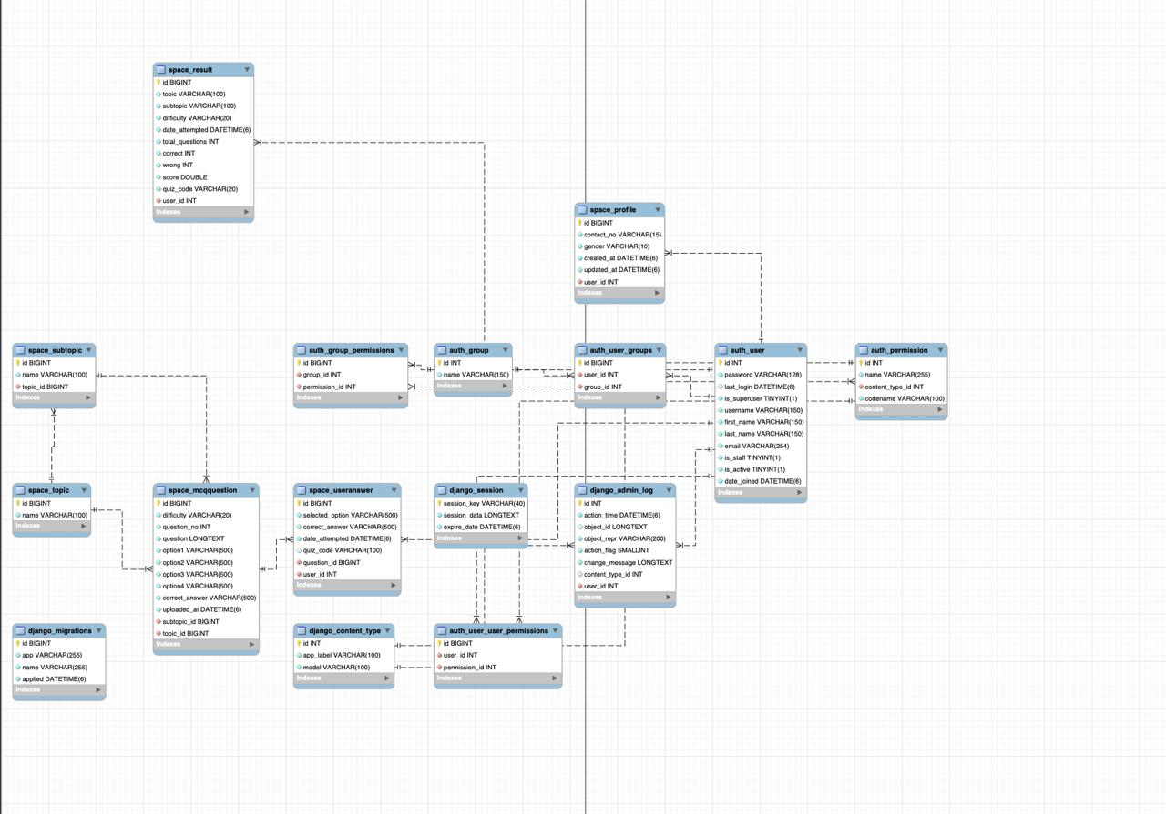
Class diagram

Slide 6
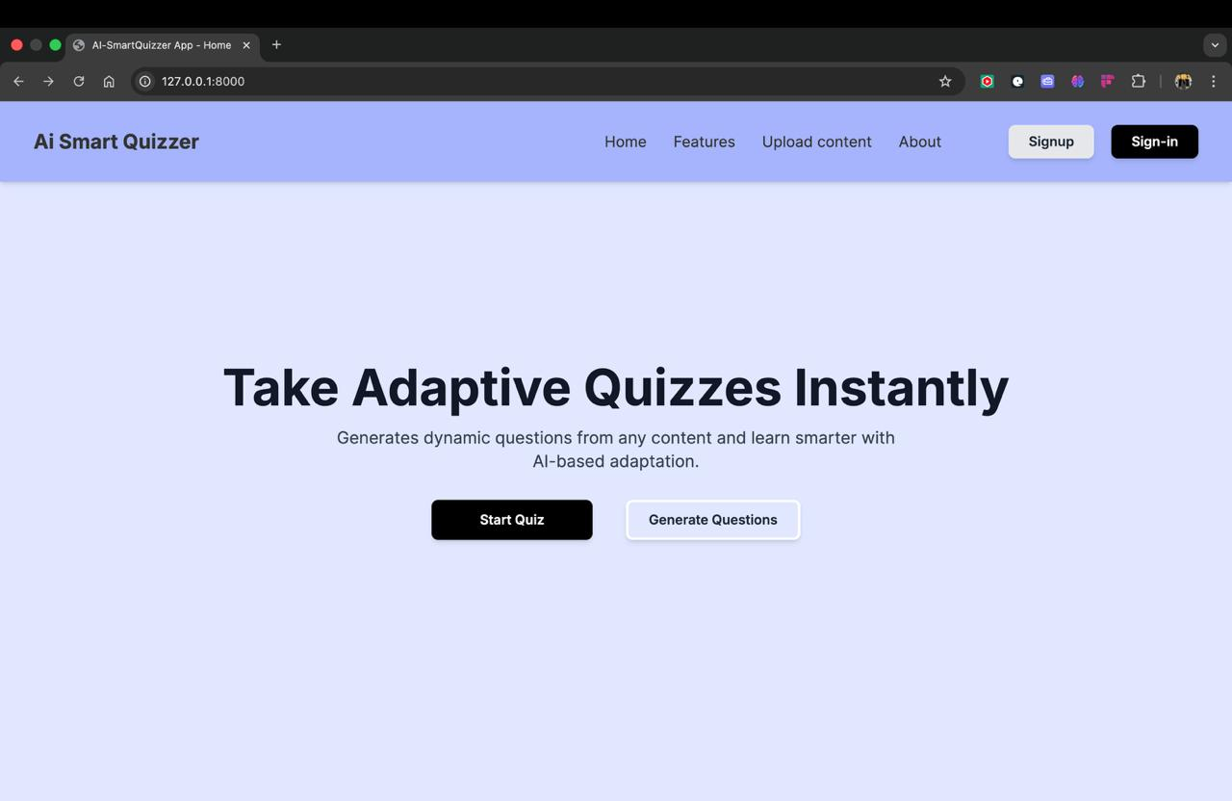
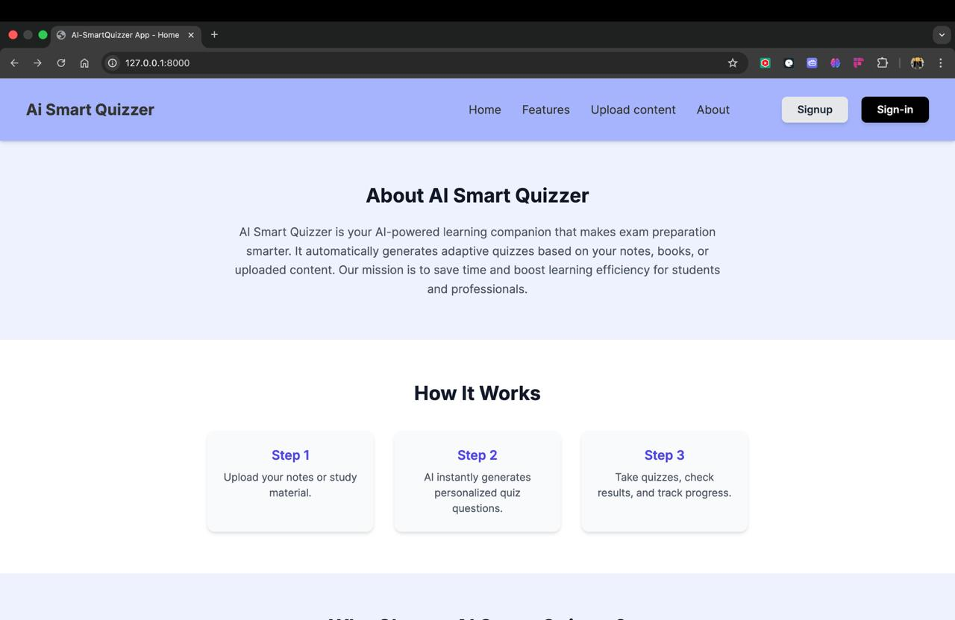
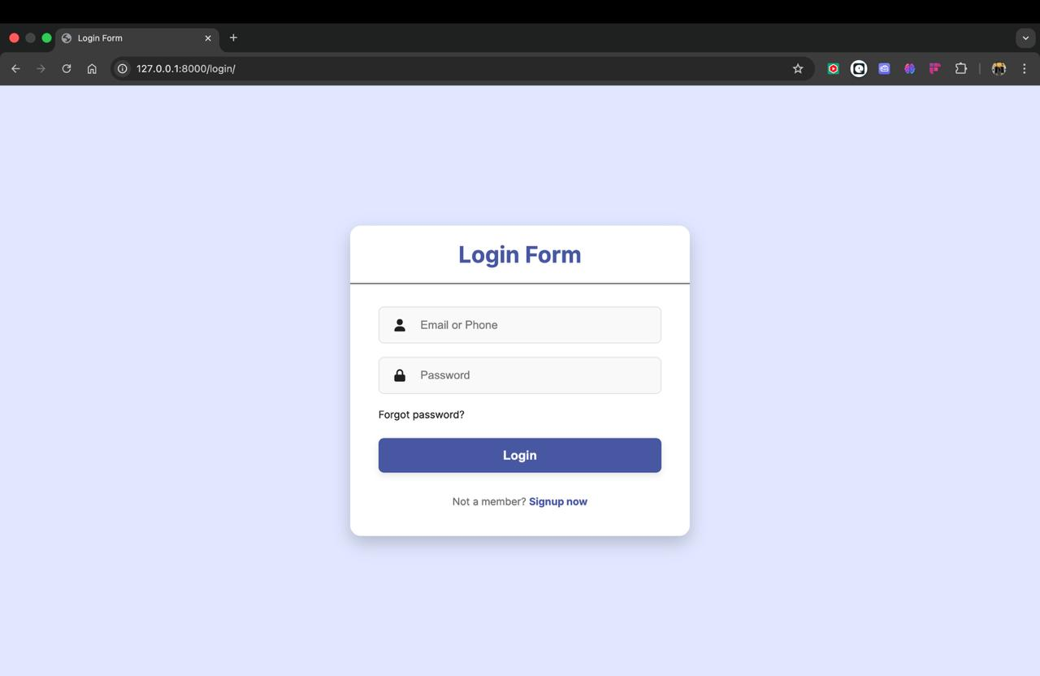
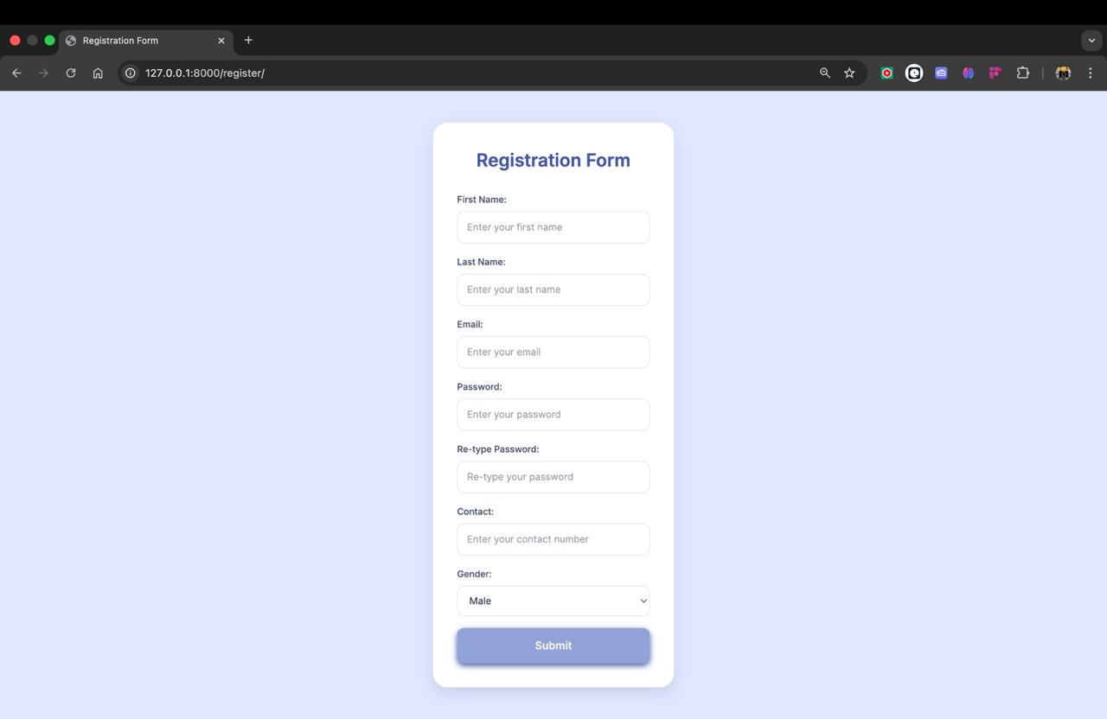
Login/ registration pages

Slide 7
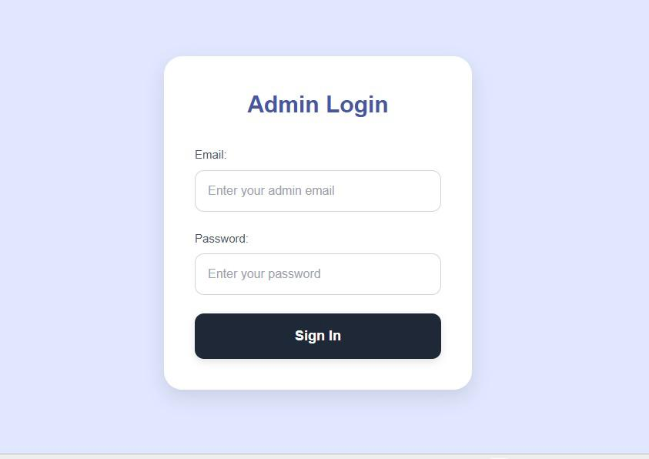
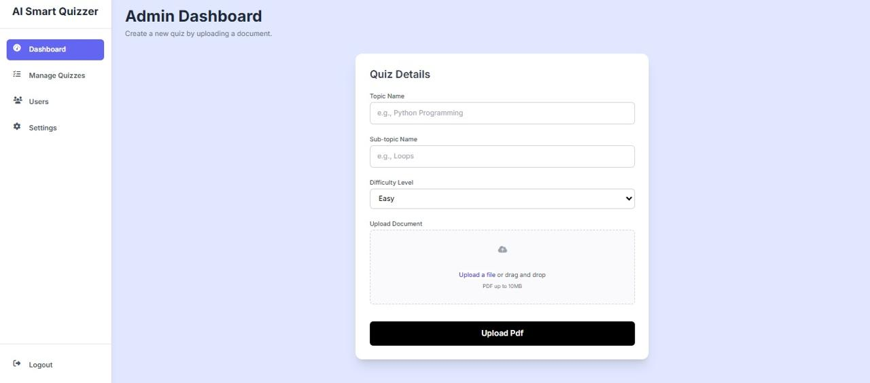
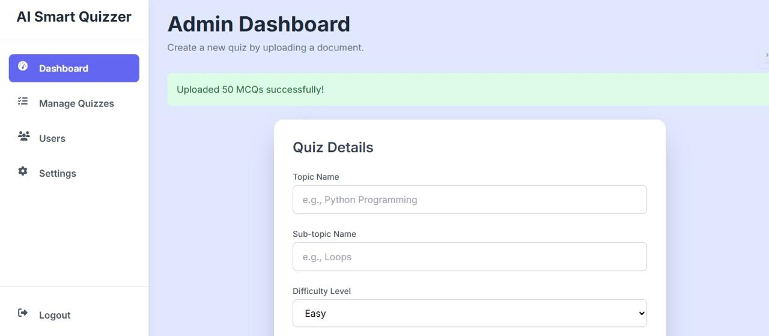
Admin Portal:

Slide 8
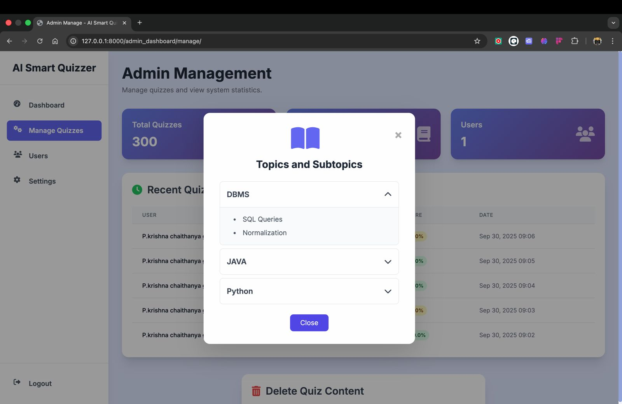
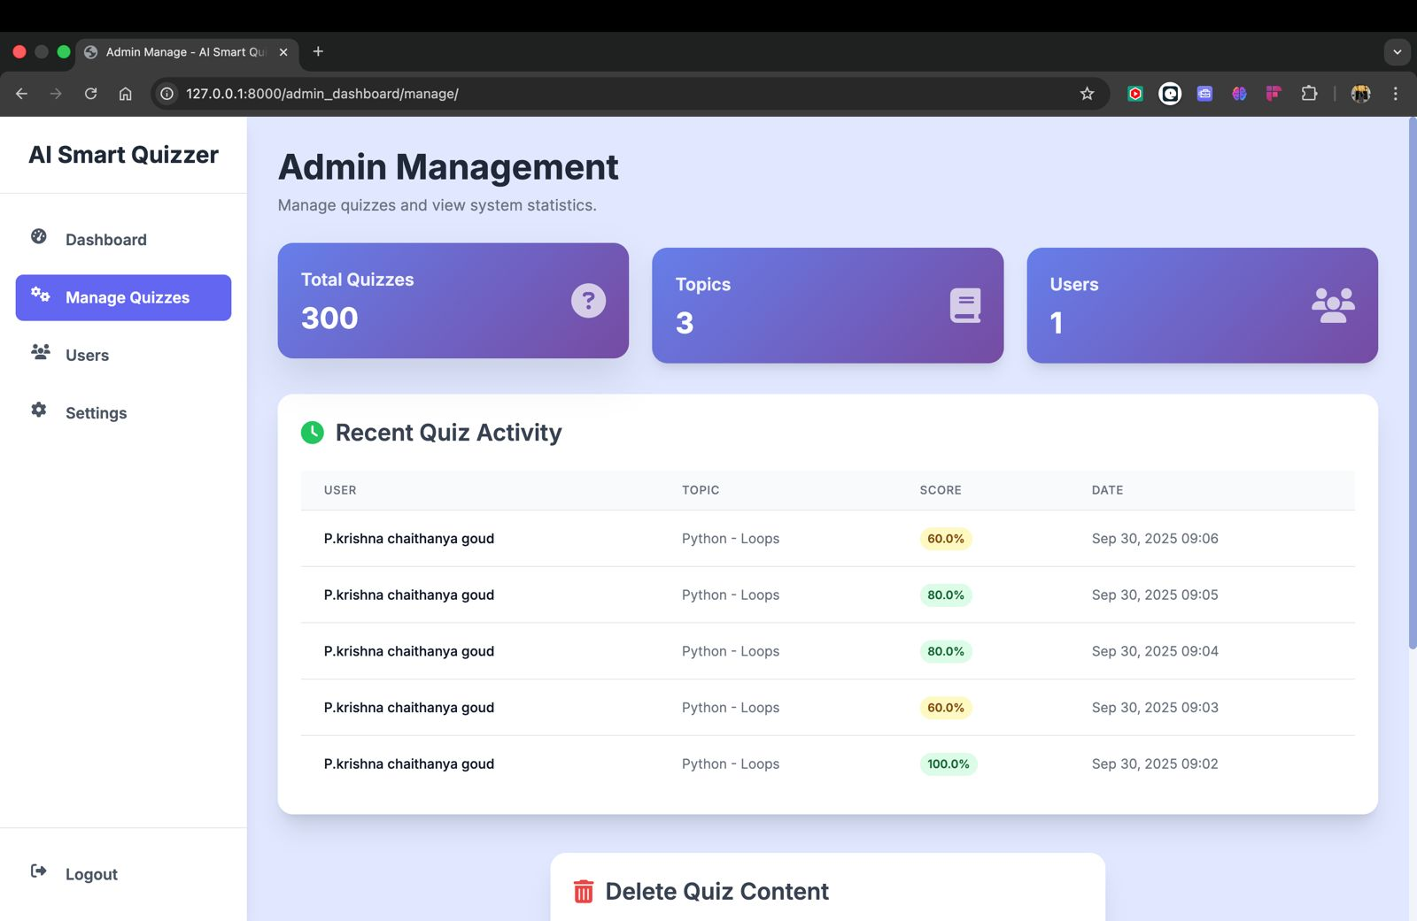
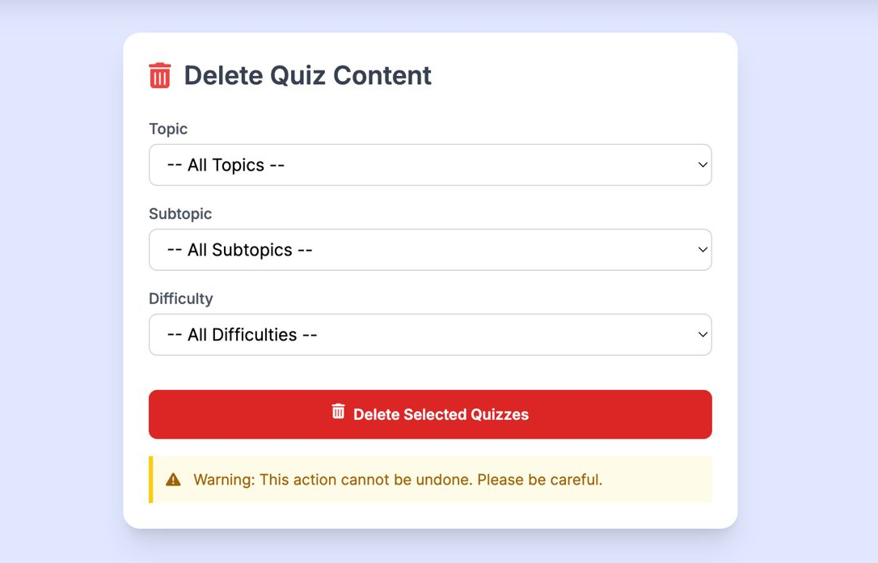

Slide 9
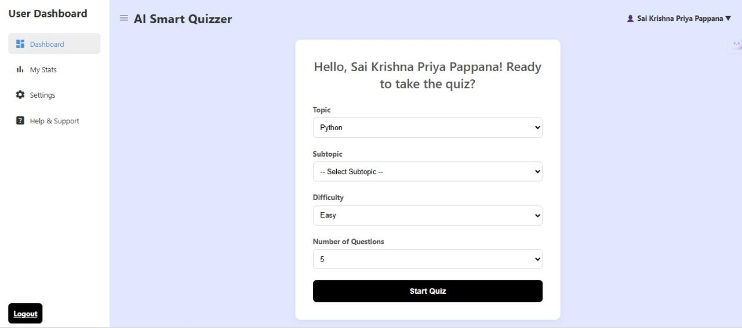
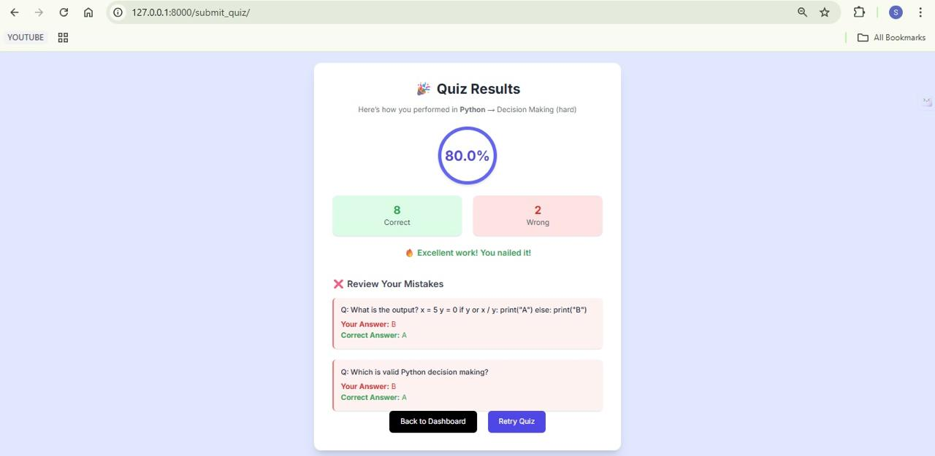
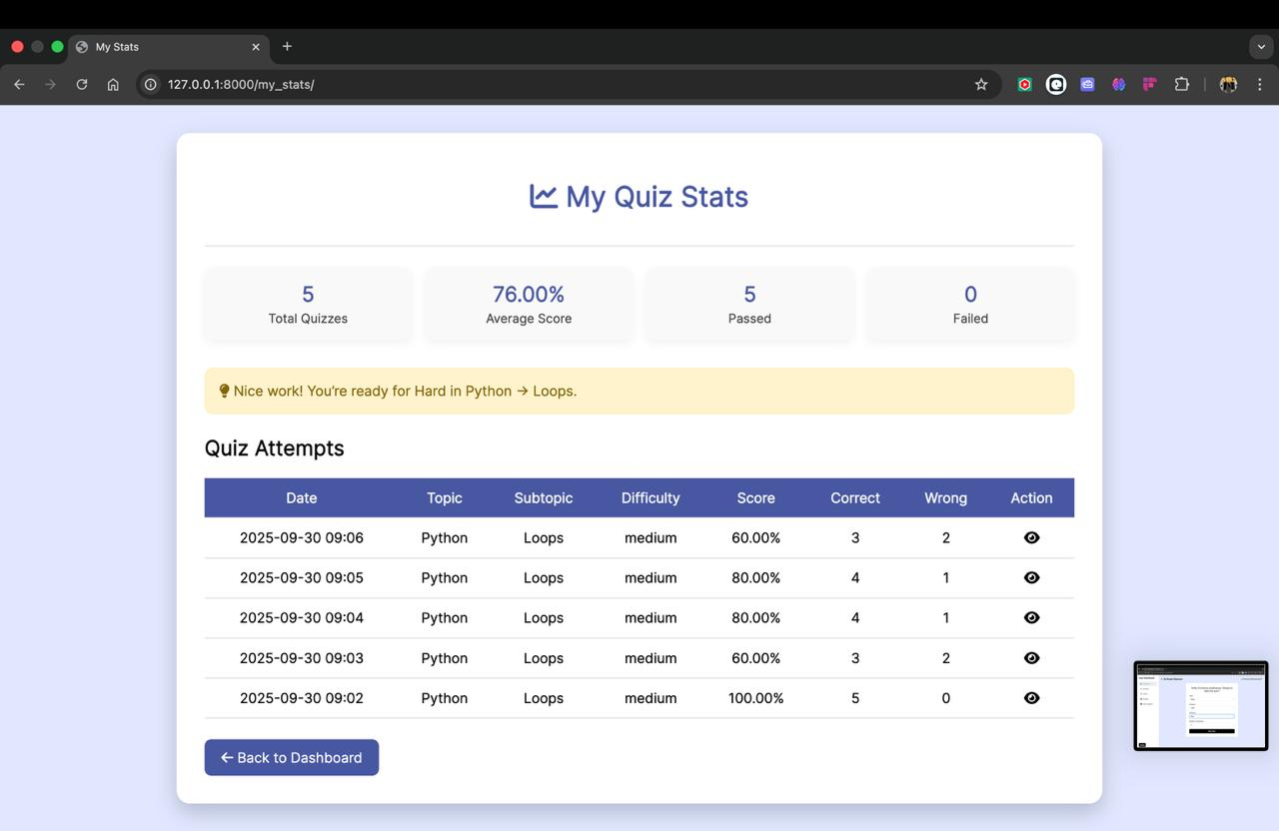
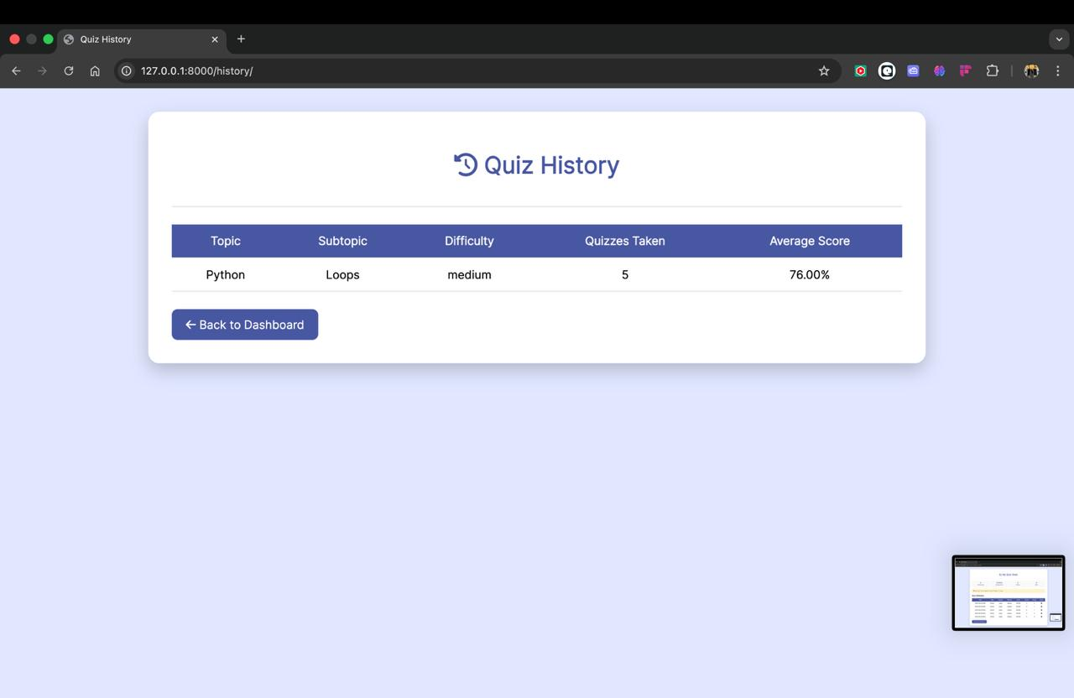
User Portal:

Slide 10
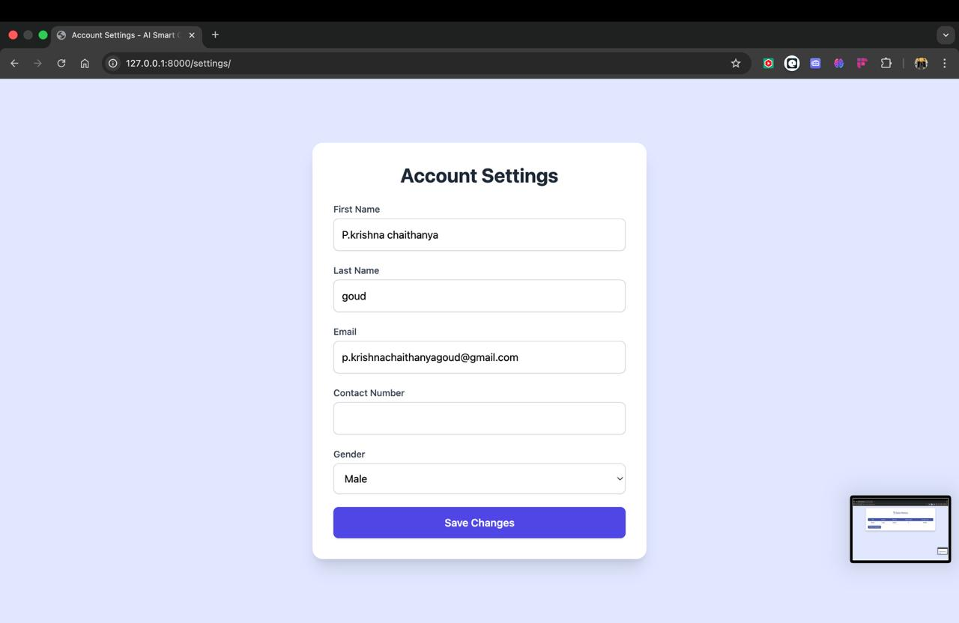
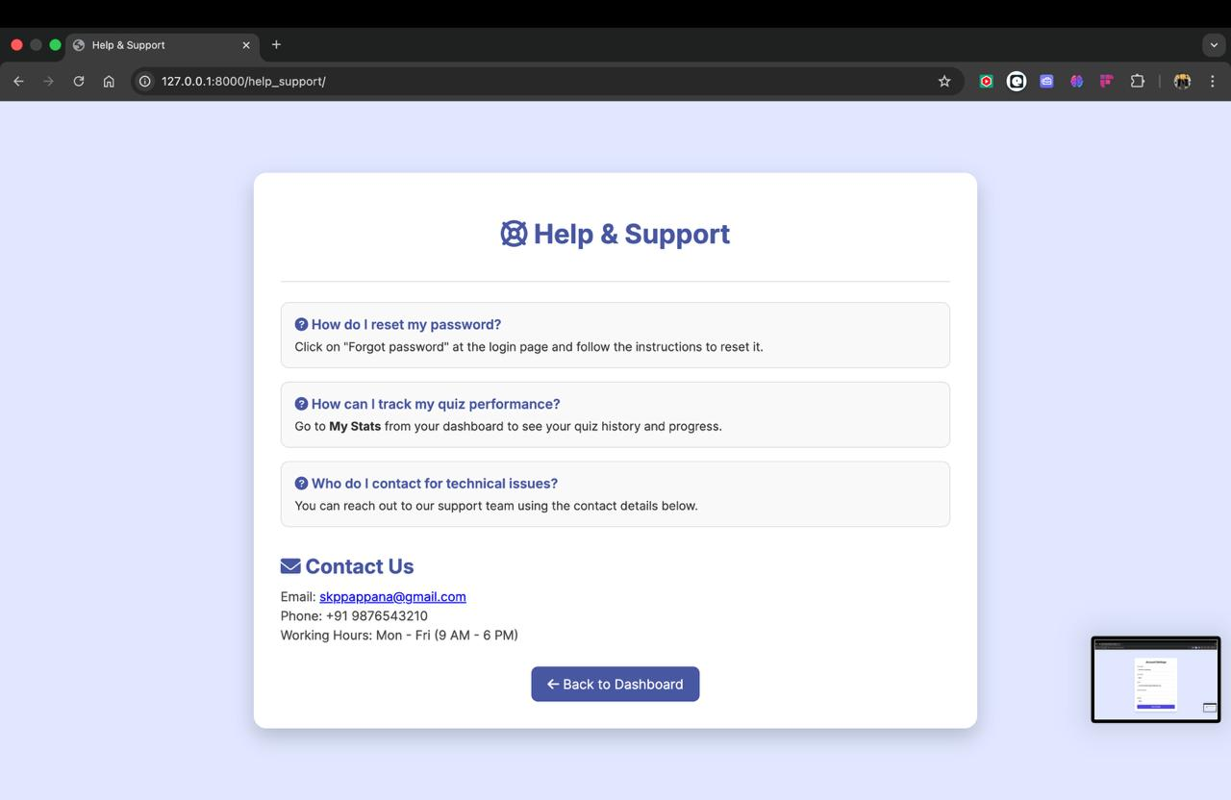
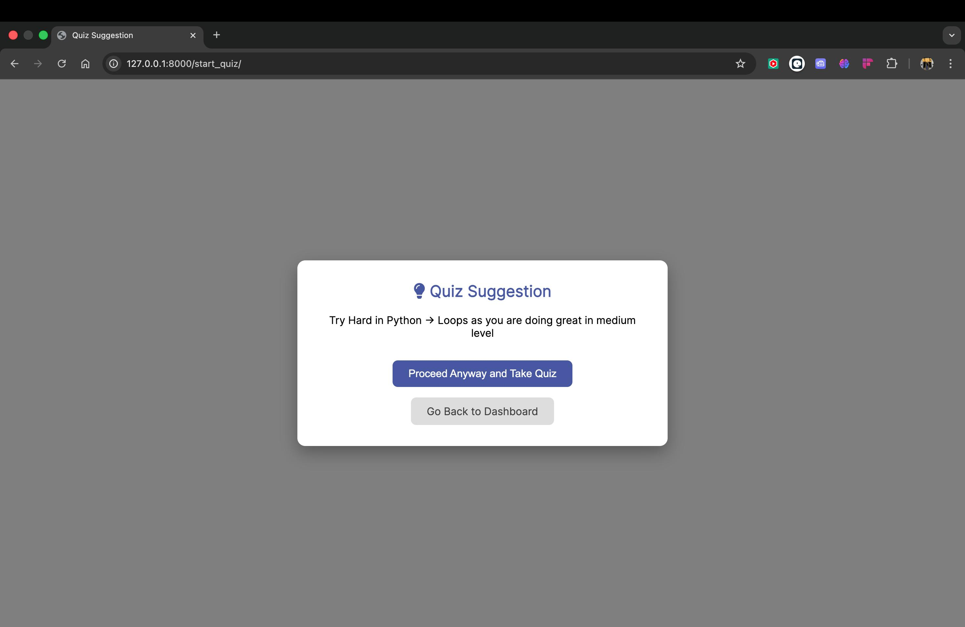

Slide 11
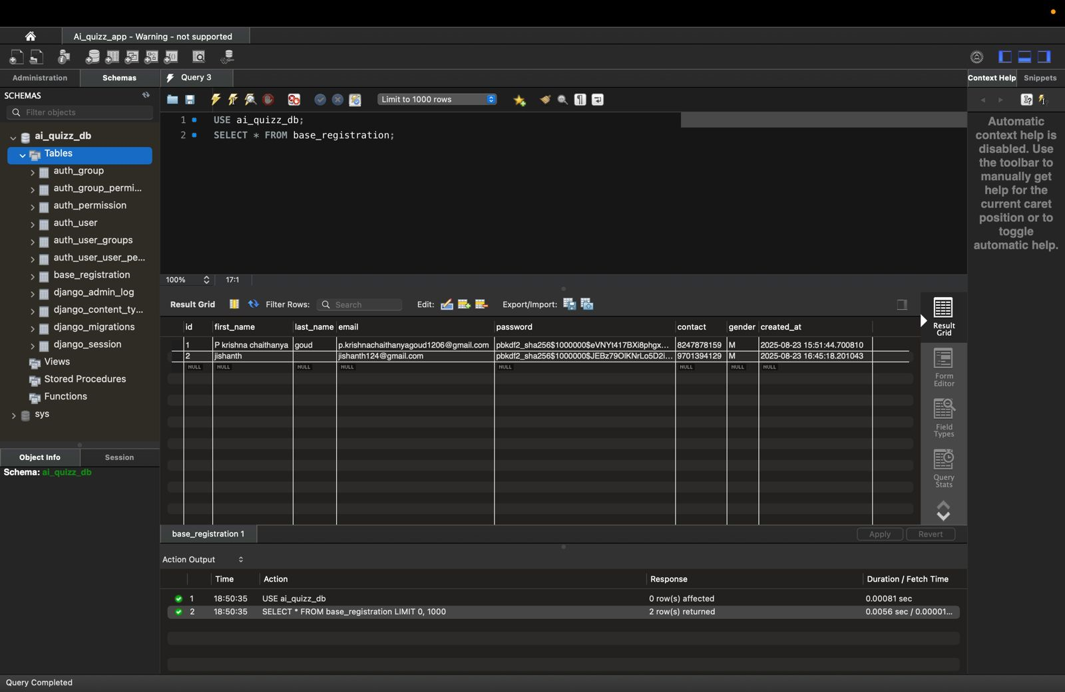
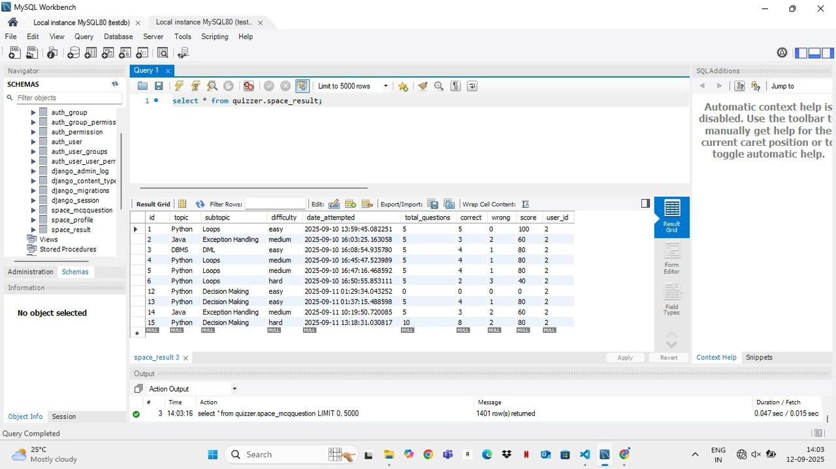
Database:

Slide 12
Conclusion
The journey from a basic concept to the final version of the AI Smart Quizzer has been a testament to our team's dedication. What began with foundational user management in Milestone 1 evolved through key feature implementations in Milestone 2. We then significantly enhanced the user experience with detailed progress tracking in Milestone 3.
Our final step in Milestone 4, the implementation of our AI-driven suggestion system, is the culmination of this journey. This system, which provides personalized recommendations based on a user's quiz history, transforms the application into a truly intelligent and adaptive learning tool.
By focusing on a seamless user experience, secure functionality, and data-driven personalization, we have successfully created a platform that addresses the critical gap in traditional learning methods. The AI Smart Quizzer is more than just a quiz generator; it is a comprehensive educational companion designed to empower learners to reach their full potential.

Slide 13
Team Members:
P. Krishna Chaithanya Goud
Pallapothu Naga Krishna Madhurima
Pappana Sai Krishna Priya
Premi Kotnala
Punam Marathe

Slide 14

Thank You

